Slide 1


2024 Budget Session
Feb 12 – Mar 8
State of Wyoming
67th Legislature
Monday | Tuesday | Wednesday | Thursday | Friday
12 Session Convenes Bill Introduction | 13 CoW Bill Introduction | 14 Bills to LSO – Noon CoW/2nd Read Bill Introduction | 15 Budget CoW Approps – Budget Bill Introduction | 16 Final Bill Introductions Budget CoW cont’d Approps – Budget Bill Introduction
19 Budget 2nd Reading Budget Amendments CoW/2nd Read/3rd Read | 20 CoW/2nd Read/3rd Read | 21 Budget 3rd Reading Committee Origin Budget Amendments CoW/2nd Read/3rd Read | 22 CoW House of Origin CoW/2nd Read/3rd Read | 23 2nd Reading Origin 2nd Read/3rd Read
26 3rd Reading Origin CROSS-OVER 3rd Read | 27 CoW/2nd Read/3rd Read | 28 CoW/2nd Read/3rd Read | 29 CoW/2nd Read/3rd Read | 1 Interim Topic Requests CoW/2nd Read/3rd Read
4 Committee 2nd House Adopt Budget JCC CoW/2nd Read/3rd Read | 5 CoW 2nd House CoW/2nd Read/3rd Read | 6 2nd Reading 2nd House 2nd Read/3rd Read | 7 3rd Reading 2nd House 3rd Read | 8 All JCC Reports – 2 pm Session Adjourns
Legend
Deadlines: literally, bills dead at that step House of Origin
Budget Second House
https://wyoleg.gov/docs/SessionSchedule.pdf

Slide 2
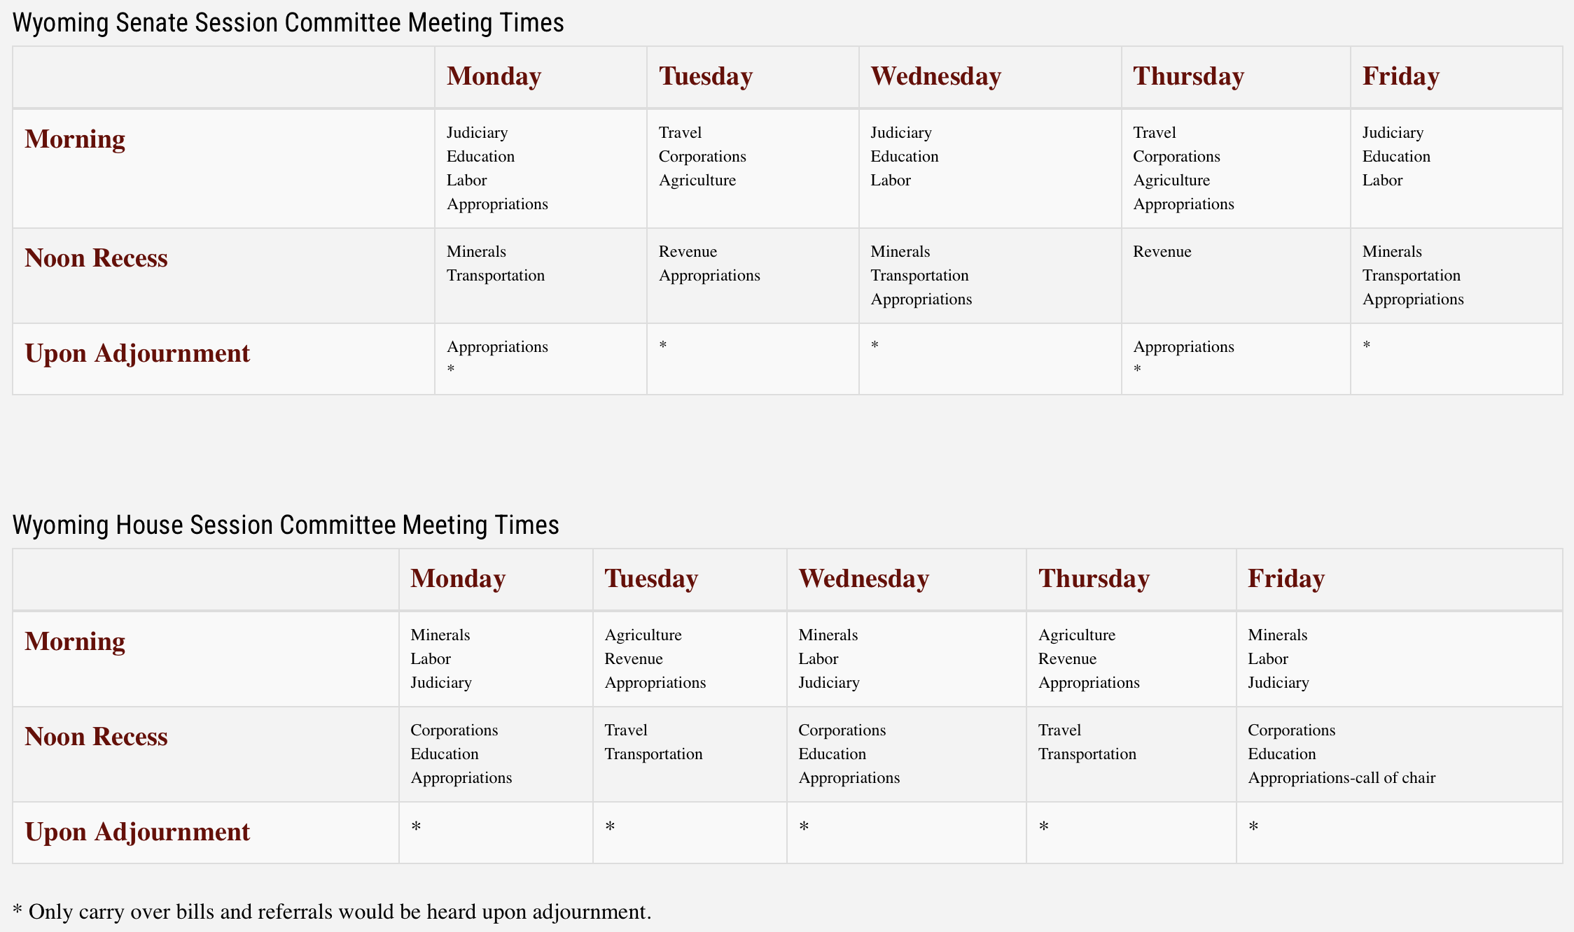
Standing Committee Meeting Times

